Slide 1


Slide 2















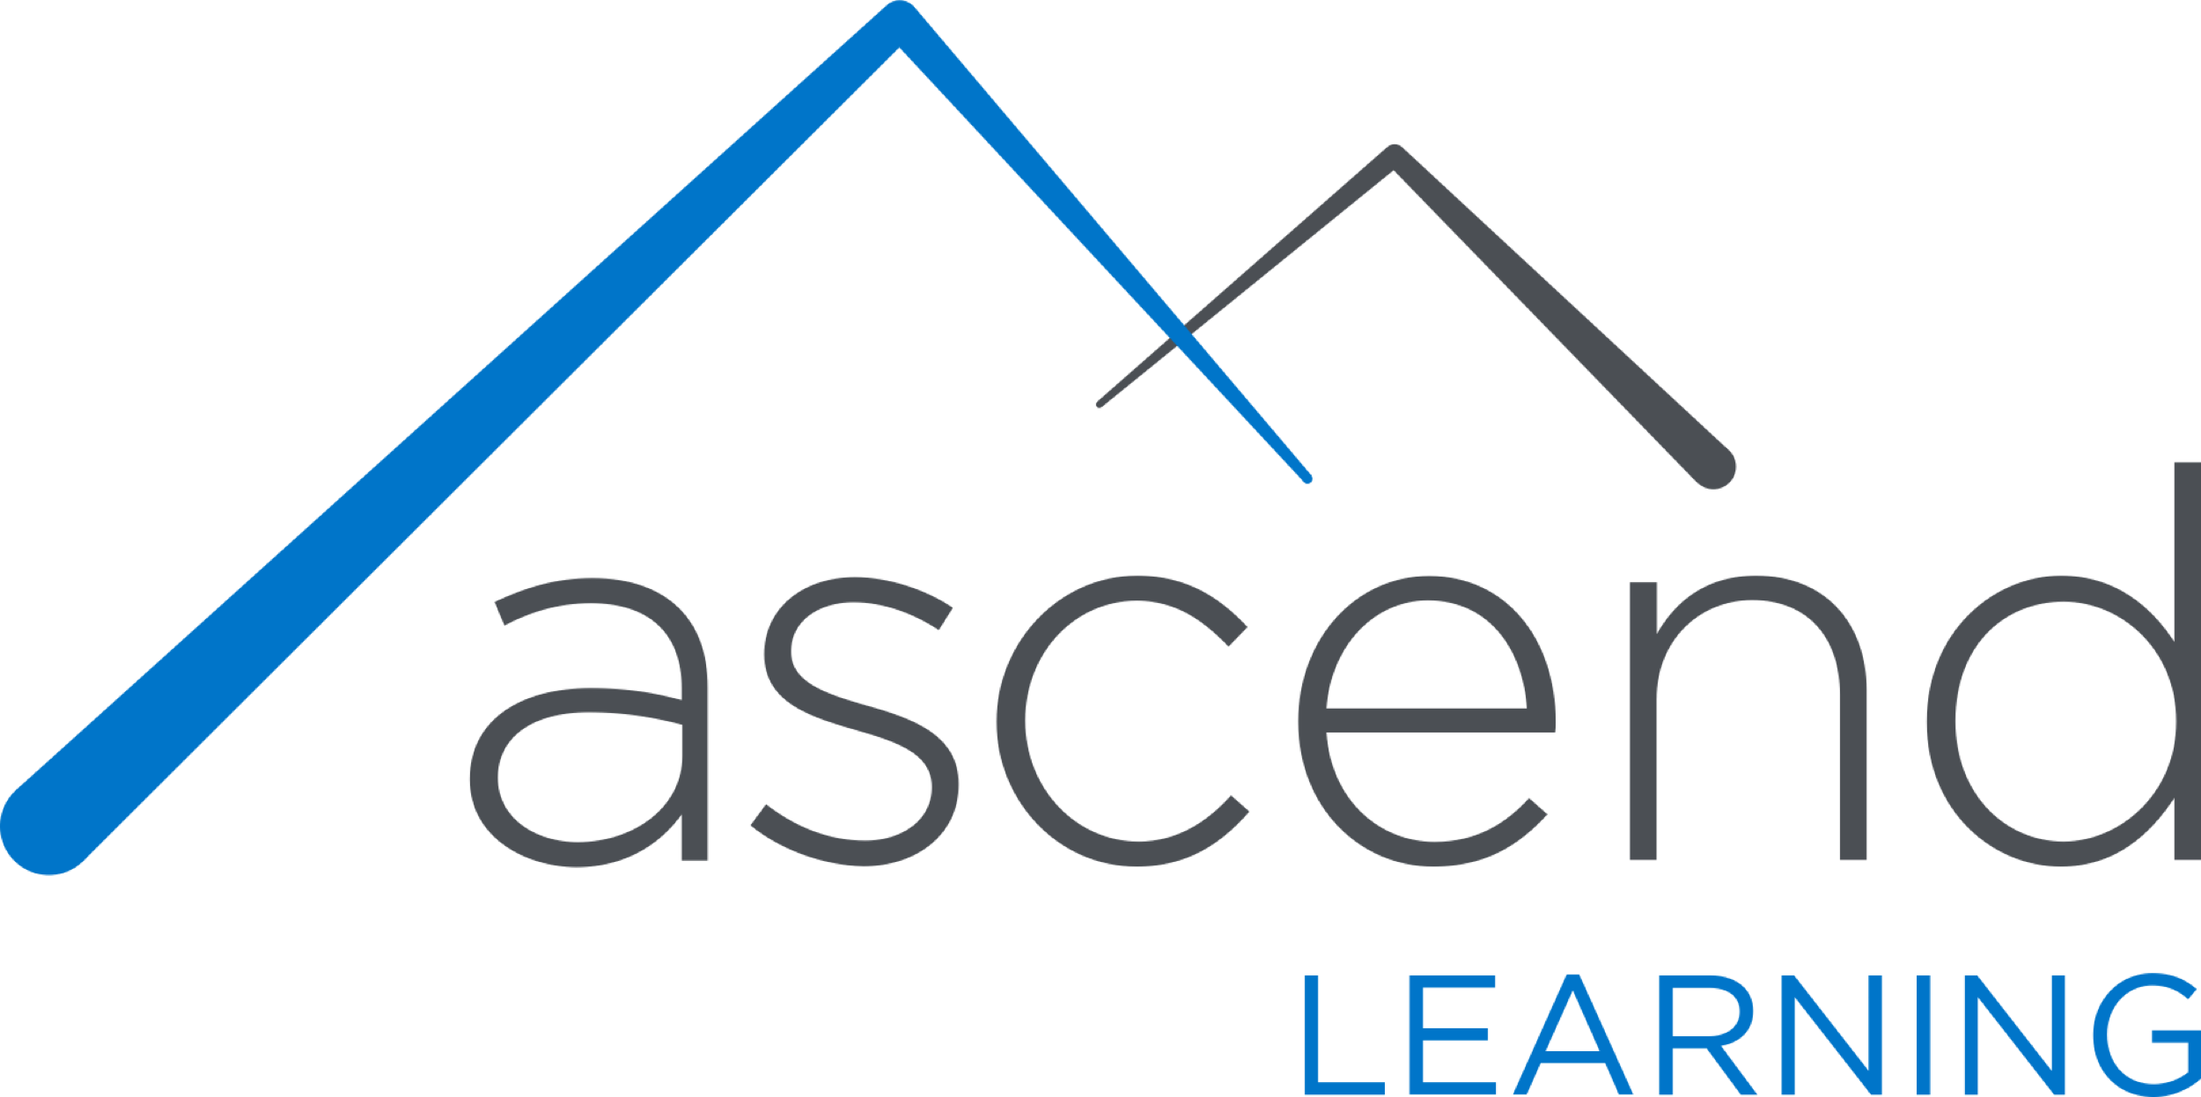
















Titanium Sponsors
Platinum Sponsors
Gold Sponsors

Slide 3

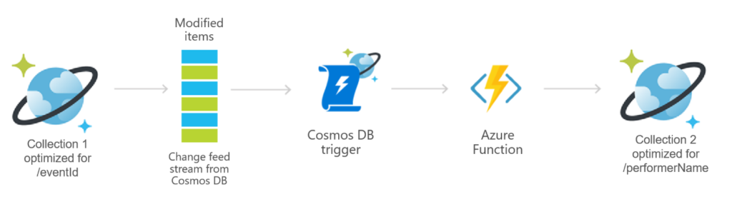
David Bowie - Changes
Ch-ch-ch-changes: Tracing Changes in Azure Cosmos DB
Time may change me
But I can’t trace time
I said that time may change me
But I can’t trace time
Notes:
David Bowie might not be able to trace how time changes him, but the Azure Cosmos DB change feed allows us to trace the changes to your data within your Cosmos database. <CLICK>The Azure Cosmos DB change feed listens to an Azure Cosmos container for any changes and then outputs the sorted lists of documents that were changed.
In this session, you learn what the change feed is, how it works, and how you can use it to build more robust applications.

Slide 4








Who is Chad Green
chadgreen@chadgreen.com
TaleLearnCode
ChadGreen.com
ChadGreen & TaleLearnCode
ChadwickEGreen

Slide 5
What is Cosmos DB
Ch-ch-ch-changes: Tracing Changes in Azure Cosmos DB

Slide 6
Azure Cosmos DB
What is Cosmos DB
A globally distributed, massively scalable, multi-model database service

Slide 7

Azure Cosmos DB
A globally distributed, massively scalable, multi-model database service
Turnkey global distribution
Notes:
Turnkey Global Distribution
Enables you to build highly responsive and highly available applications worldwide
Transparently replicates your data wherever your users are, so your users can interact with a replica of the data that is closest to them
Add or remove any of the Azure regions to your Cosmos account at any time, with a click of a button
Cosmos DB will seamlessly replicate your data to all the regions associated with your account while your application continues to be highly available, thanks to the multi-homing capabilities
Always On
By virtue of deep integration with Azure infrastructure and transparent multi-master replication, Cosmos DB provides 99.999% high availability for both reads and writes.
Provides you the ability to programmatically or via Portal invoke the regional failover of your Cosmos account
Helps ensure that your application is designed to failover in the case of regional disaster

Slide 8
Azure Cosmos DB
A globally distributed, massively scalable, multi-model database service
Turnkey global distribution
Notes:
NEXT: Elastic scale out of storage & throughput

Slide 9
Azure Cosmos DB
A globally distributed, massively scalable, multi-model database service
Elastic scale out of storage & throughput
Turnkey global distribution
Notes:
Elastic scalability of throughput and storage, worldwide
Designed with transparent horizontal partitioning and multi-master replication
Offers unprecedent elastic scalability for your writes and reads, all around the globe
Elastically scale up from thousands to hundreds of millions of requests per second around the global with a single API call and pay only for the throughput (and storage) you need
Helps you deal with unexpected spikes in your workloads without having to over-provision for the peak

Slide 10
Azure Cosmos DB
A globally distributed, massively scalable, multi-model database service
Elastic scale out of storage & throughput
Turnkey global distribution
Notes:
NEXT: Guaranteed low latency at the 99th percentile

Slide 11
Azure Cosmos DB
A globally distributed, massively scalable, multi-model database service
Guaranteed low latency at the 99th percentile
Elastic scale out
of storage & throughput
Turnkey global distribution
Notes:
Guaranteed low latency at 99th percentile, worldwide
Using Cosmos DB, you can build highly responsive, planet scale applications
With its novel multi-master replication protocol and latch free and write-optimized database engine, Cosmos guarantees less than 10-ms latencies for both, reads (indexed) and writes at 99th percentile, all around the world
Capability ensures sustained ingestion of data and blazing-fast queries for highly responsive apps

Slide 12
Azure Cosmos DB
A globally distributed, massively scalable, multi-model database service
Guaranteed low latency at the 99th percentile
Elastic scale out
of storage & throughput
Turnkey global distribution
Notes:
NEXT: Five well-defined consistency models

Slide 13
Azure Cosmos DB
A globally distributed, massively scalable, multi-model database service
Five well-defined consistency models
Guaranteed low latency at the 99th percentile
Elastic scale out
of storage & throughput
Turnkey global distribution
Notes:
Strong; Bounded Staleness; Session; Consistent Prefix; Eventual

Slide 14
Azure Cosmos DB
A globally distributed, massively scalable, multi-model database service
Five well-defined consistency models
Guaranteed low latency at the 99th percentile
Elastic scale out
of storage & throughput
Turnkey global distribution
Notes:
Strong; Bounded Staleness; Session; Consistent Prefix; Eventual

Slide 15
Azure Cosmos DB
A globally distributed, massively scalable, multi-model database service
Comprehensive
SLAs
Guaranteed low latency at the 99th percentile
Elastic scale out
of storage & throughput
Five well-defined consistency models
Turnkey global distribution
Notes:
Industry Leading Comprehensive SLAs
First and only service to offer industry-leading comprehensive SLAs encompassing 5-nine availability, read and write latency at the 99th percentile, guaranteed throughput, and consistency.

Slide 16
Azure Cosmos DB
A globally distributed, massively scalable, multi-model database service
Comprehensive
SLAs
Guaranteed low latency at the 99th percentile
Elastic scale out
of storage & throughput
Five well-defined consistency models
Turnkey global distribution

Slide 17
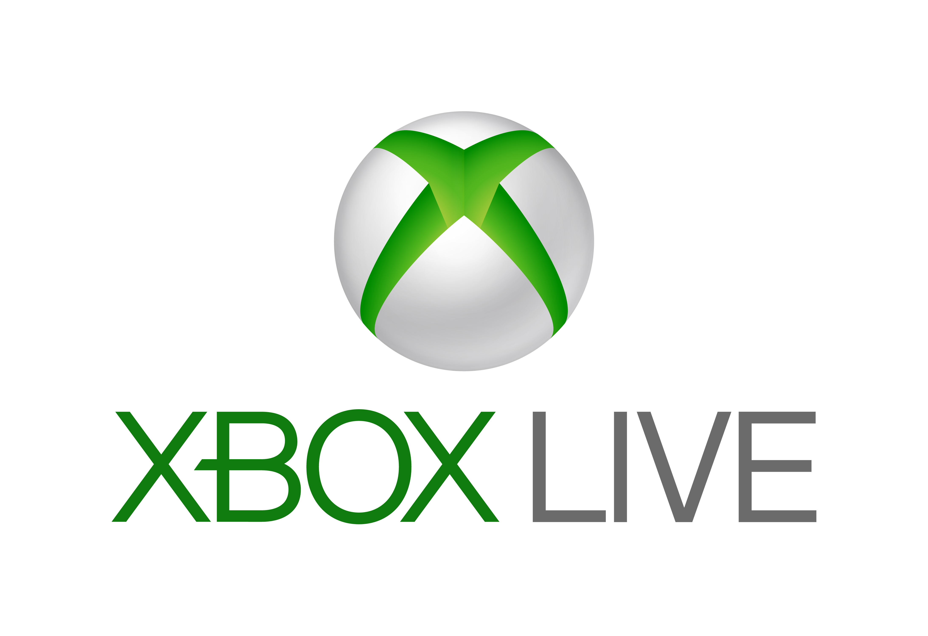



Azure Cosmos DB
A globally distributed, massively scalable, multi-model database service
Battle Tested
Guaranteed low latency at the 99th percentile
Elastic scale out
of storage & throughput
Five well-defined consistency models
Comprehensive
SLAS
Turnkey global distribution
Notes:
Battle tested database service
Cosmos DB is a foundational service in Azure
For nearly a decade, Cosmos DB has been used by many of Microsoft’s products for mission critical applications at global scale
Skype, Xbox, Office 365, Azure, and many others
One of the fastest growing services on Azure

Slide 18











Azure Cosmos DB
A globally distributed, massively scalable, multi-model database service
Battle Tested
Guaranteed low latency at the 99th percentile
Elastic scale out
of storage & throughput
Five well-defined consistency models
Comprehensive
SLAS
Turnkey global distribution

Slide 19
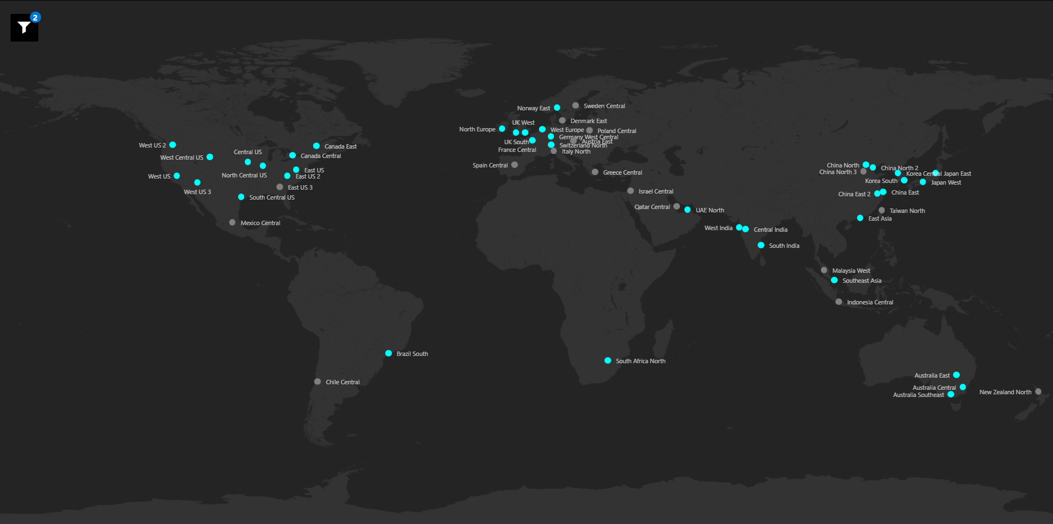
Azure Cosmos DB
A globally distributed, massively scalable, multi-model database service
Ubiquitous Regional Presence
Guaranteed low latency at the 99th percentile
Elastic scale out
of storage & throughput
Five well-defined consistency models
Comprehensive
SLAS
Turnkey global distribution
Notes:
Ubiquitous regional presence
Azure public cloud
Azure China 21Vianet (one of China’s largest internet providers)
Azure Germany (data remains in country)
Azure Government (4 regions)
Azure Government for Department of Defense (2 regions)
68 regions

Slide 20
Azure Cosmos DB
A globally distributed, massively scalable, multi-model database service
Secure by default and enterprise ready
Guaranteed low latency at the 99th percentile
Elastic scale out
of storage & throughput
Five well-defined consistency models
Comprehensive
SLAS
Turnkey global distribution
Notes:
Secure by default and enterprise ready
Certified for a wide array of compliance standards
CSA STAR Certification\CSA STAR Attestation
ISO 20000-1:2011, 22301:2012, 27001:2013, 27017:2015, 27018:2014
SOC 1,2,3
DoD SRP Level 2
FedRAMP Moderate
GxP
HIPPA
HITRUST
PCI DSS
Australian IREP Unclassifed
Germany C5
Singapore MTCS Level 3
Spain ENS High
Encrypted at rest and in motion
Provides row level authorization and adheres to strict security standards

Slide 21




Azure Cosmos DB
A globally distributed, massively scalable, multi-model database service
Core (SQL) API
Table API
MongoDB
Column-family
Document
Key-value
Graph
Guaranteed low latency at the 99th percentile
Elastic scale out
of storage & throughput
Five well-defined consistency models
Turnkey global distribution
Comprehensive SLAs

Slide 22
Change Feed
Ch-ch-ch-changes: Tracing Changes in Azure Cosmos DB

Slide 23

Overview
Change Feed
Notes:
The change feed listens to an Azure Cosmos container for any changes. It then outputs a sorted list of documents that were changed in the order in which they were modified. The changes are persisted, can be processed asynchronously and incrementally, and the output can be distributed across one or more consumers for parallel processing.

Slide 24

Overview
Change Feed
Notes:
NEXT: Unsung Hero of Azure Cosmos DB

Slide 25
Overview
Change Feed
Unsung Hero of Azure Cosmos DB

Slide 26
Overview
Change Feed
Enabled by default
Notes:
Change feed is enabled by default for all Azure Cosmos accounts
You use the provisioned throughput to read from the change feed, just like any other Azure Cosmos DB operation, in any of the regions associated with your Azure Cosmos database.

Slide 27
Overview
Change Feed
Enabled by default
Enabled by default

Slide 28
Overview
Change Feed
Enabled by default
Includes insert and update operations
Notes:
The change feed includes inserts and update operations made to items within the container.
You can capture deletes by setting a “soft-delete” flag within your documents in place of deletes.
Alternatively, you can set a finite expiration period for your items with the TTL capability.

Slide 29
Overview
Change Feed
Enabled by default
Includes insert and update operations
Includes insert and update operations

Slide 30
Overview
Change Feed
Enabled by default
Includes insert and update operations
Each change appears exactly once
Notes:
Each change to an item appears exactly once in the change feed

Slide 31
Overview
Change Feed
Enabled by default
Includes insert and update operations
Each change appears exactly once
Each change appears exactly once
Notes:
Each change appears exactly once

Slide 32
Overview
Change Feed
Enabled by default
Includes insert and update operations
Each change appears exactly once
Clients manage checkpointing logic
Notes:
And the clients must manage the checkpointing logic.
If you want to avoid the complexity of managing checkpoints, the change feed processor provides automatic checkpointing and “at least once” semantics.

Slide 33
Overview
Change Feed
Enabled by default
Includes insert and update operations
Each change appears exactly once
Clients manage checkpointing logic
Clients manage checkpointing logic
Notes:
Clients manage checkpointing logic

Slide 34
Overview
Change Feed
Enabled by default
Includes insert and update operations
Each change appears exactly once
Sorted by order of modification
Clients manage checkpointing logic
Notes:
The change feed is sorted by the order of modification within each logical partition

Slide 35
Overview
Change Feed
Enabled by default
Includes insert and update operations
Each change appears exactly once
Sorted by order of modification
Clients manage checkpointing logic
Sorted by order of modification
Notes:
Sorted by order of modification

Slide 36
Overview
Change Feed
Enabled by default
Includes insert and update operations
Each change appears exactly once
No guaranteed order logical partitions
Clients manage checkpointing logic
Sorted by order of modification
Notes:
There is no guaranteed order across the partitions.

Slide 37
Overview
Change Feed
Enabled by default
Includes insert and update operations
Each change appears exactly once
No guaranteed order logical partitions
Clients manage checkpointing logic
Sorted by order of modification
No guaranteed order logical partitions
Notes:
No guaranteed order across logical partitions

Slide 38
Overview
Change Feed
Enabled by default
Includes insert and update operations
Each change appears exactly once
Synchronized from any point-in-time
Clients manage checkpointing logic
Sorted by order of modification
No guaranteed order logical partitions
Notes:
Changes can be synchronized from any point-in-point, that is there is no fixed data retention period for which changes are available.

Slide 39
Overview
Change Feed
Enabled by default
Includes insert and update operations
Each change appears exactly once
Synchronized from any point-in-time
Clients manage checkpointing logic
Sorted by order of modification
No guaranteed order logical partitions
Synchronized from any point-in-time
Notes:
Synchronized from any point-in-time

Slide 40
Overview
Change Feed
Enabled by default
Includes insert and update operations
Each change appears exactly once
Changes available in parallel for logical partitions
Clients manage checkpointing logic
Sorted by order of modification
No guaranteed order logical partitions
Synchronized from any point-in-time
Notes:
Changes are available in parallel for all logical partition keys of an Azure Cosmos container.
This capacity allows changes from large containers to be processed in parallel by multiple consumers.

Slide 41
Overview
Change Feed
Enabled by default
Includes insert and update operations
Each change appears exactly once
Changes available in parallel for logical partitions
Clients manage checkpointing logic
Sorted by order of modification
No guaranteed order logical partitions
Synchronized from any point-in-time
Changes available in parallel for logical partitions
Notes:
Changes available in parallel for logical partitions

Slide 42
Overview
Change Feed
Enabled by default
Includes insert and update operations
Each change appears exactly once
Applications can request multiple change feeds
Clients manage checkpointing logic
Sorted by order of modification
No guaranteed order logical partitions
Synchronized from any point-in-time
Changes available in parallel for logical partitions
Notes:
Applications can request multiple change feeds on the same container simultaneously.
ChangeFeedOptions.StartTime can be used to provide an initial starting point.
For example, to find the continuation token corresponding to given clock time. The ContinuationToken, if specified, takes precedence over the StartTime and StartFromBegininning values. The precision of ChangeFeedOptions.StartTime is ~ 5 seconds.

Slide 43









Supported APIs and Client SDKs
Change Feed
X
Notes:
The change feed is currently supported by:
SQL API
Cassandra
MongoDB
Gremlin API
Not supported by the Table API
Drivers are available for:
.NET
Java
Python
Node/JS

Slide 44
Supported APIs and Client SDKs
Change Feed
Notes:
Change feed functionality is surfaced as change stream in MongoDB API and Query with predicate in Cassandra API.
Native Apache Cassandra provides change data capture (CDC), a mechanism to flag specific tables for archival as well as rejecting writes to those tables once a configurable size-on-disk for the CDC log is reached. The change feed feature in Azure Cosmos DB API for Cassandra enhances the ability to query the changes with predicate via CQL.

Slide 45
Current Limitations
Change Feed
Intermediate Updates
Notes:
Only the most recent change for a given item is included in the change feed. When processing changes, you will read the latest available item version. If there are multiple updates to the same item in a short period of time, it is possible to missing processing intermediate updates. If you would like to track updates and be able to replay past updates to an item, we recommend modeling these updates as a series of writes instead.

Slide 46
Current Limitations
Change Feed
Intermediate Updates
Notes:
NEXT: Guaranteed order

Slide 47
Current Limitations
Change Feed
Intermediate Updates
Guaranteed Order
Notes:
There is guaranteed order in the change feed within a partition key but not across partition key values. You should select a partition key that gives you a meaningful order guarantee.
For example, consider a retail application using the event sourcing design pattern. In this application, different user actions are each “events” which are modeled as writes to Azure Cosmos DB. Imagine if some example events occurred in the following sequence:
Customer adds Item A to their shopping cart
Customer adds Item B to their shopping cart
Customer removes Item A from their shopping cart
Customer checks out and shopping cart contents are shipped
A materialized view of current shopping caret contents is maintained for each customer. This application must ensure that these events are processed in the order in which they occur. If, for example, the cart checkout were to be processed before Item A’s removal, it is likely that the customer would have Item A shipped, as opposed to the desired Item B. In order to guarantee that these four events are processed in order of their occurrence, they should fail within the same partition key value. If you select username (each customer has a unique username) as the partition key, you can guarantee that these events show up in the change feed in the same order in which they are written to Azure Cosmos DB.

Slide 48
Current Limitations
Change Feed
Intermediate Updates
Guaranteed Order
Notes:
NEXT: Deletes

Slide 49
Current Limitations
Change Feed
Intermediate Updates
Deletes
Guaranteed Order
Notes:
The change feed does not capture deletes. If you delete an item from your container, it is also removed from the change feed. The most common method of handling this is adding a soft marker on the items that are being deleted. You can add a property called “deleted” and set it to “true” at the time of deletion. This document update will show up in the change feed. You can set a TTL on this item so that it can be automatically deleted leter.

Slide 50
Change Feed Processor
Ch-ch-ch-changes: Tracing Changes in Azure Cosmos DB
Notes:
You can read from the change feed directly with the SDK; but let’s look at the change feed processor
The change feed processor simplifies the process of reading the change feed and distribute the event processing across multiple consumers effectively.
The main benefit of the change feed processor library is its fault-tolerant behavior that assures an “at-least-once” delivery of all the events in the change feed.

Slide 51
Change Feed Processor Components
Reading the Change Feed
Monitored Container
Notes:
There are four main components of implementing the change feed processor:
1. The monitored container: The monitored container has the data from which the change feed is generated. Any inserts and updates to the monitored container are reflected in the change feed of the container.

Slide 52
Change Feed Processor Components
Reading the Change Feed
Monitored Container
Leased Container
Notes:
The lease container: The lease container acts as a state storage and coordinates processing the change feed across multiple workers. The lease container can be stored in the same account as the monitored container or in a separate account.

Slide 53
Change Feed Processor Components
Reading the Change Feed
Monitored Container
Leased Container
Host
Notes:
The host: A host in an application instance that uses the change feed processor to listen for changes. Multiple instances with the same lease configuration can run in parallel, but each instance should have a different instance name.

Slide 54
Change Feed Processor Components
Reading the Change Feed
Monitored Container
Leased Container
Host
Delegate
Notes:
The delegate: The delegate is the code that defines what you, the developer, what to do with each batch of changes that the change feed processor reads.

Slide 55
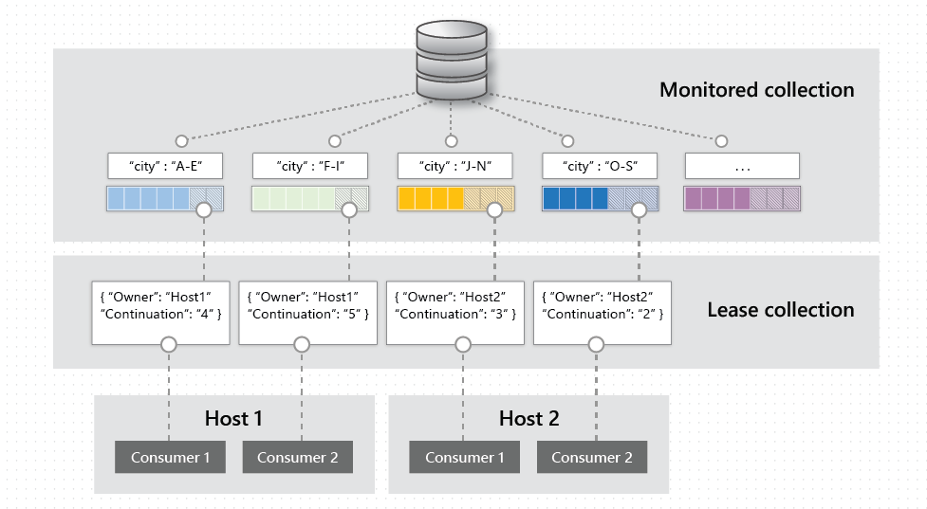
Change Feed Processor Components
Reading the Change Feed
Notes:
To further understand how these four elements of change feed processor work together, let's look at an example in the following diagram. The monitored container stores documents and uses 'City' as the partition key. We see that the partition key values are distributed in ranges that contain items. There are two host instances and the change feed processor is assigning different ranges of partition key values to each instance to maximize compute distribution. Each range is being read in parallel and its progress is maintained separately from other ranges in the lease container.

Slide 56
Processing Life Cycle
Reading the Change Feed
Read the change feed
Changes
No
Yes
Send changes to delegate
Update lease store
Notes:
The normal life cycle of a host instance is:
<CLICK> Read the change feed.
<CLICK> If there are no changes, <CLICK> sleep for a predefined amount of time and go to #1
<CLICK> If there are changes, send them to the delegate.
When the delegate finished processing the changes successfully, <CLICK> update the lease store with the latest processed point in time and <CLICK> go to #1.

Slide 57
Hosting the Change Feed Processor
Reading the Change Feed
Azure WebJob
Azure Virtual Machine
Azure Kubernetes Service
ASP.NET Hosted Service
Notes:
The change feed processor can be hosted in any platform that supports long processes or tasks:
A continuous running Azure WebJob.
A process in an Azure Virtual Machine.
A background job in Azure Kubernetes Service.
An ASP.NET hosted service

Slide 58
Serverless Event-Based Architectures
Ch-ch-ch-changes: Tracing Changes in Azure Cosmos DB
Notes:
Azure Functions provides the simplest way to connect to the change feed. You can create small reactive Azure Functions that will be automatically triggered on each new event in your Azure Cosmos container’s change feed.

Slide 59



Azure Functions
Serverless Event-Based Archictures
Notes:
Code
Events and Data

Slide 60
Azure Functions
Serverless Event-Based Architectures
Serverless
Notes:
Serverless applications: Functions allow you to develop serverless applications on Microsoft Azure.

Slide 61
Azure Functions
Serverless Event-Based Architectures
Serverless
Language Choice
Notes:
Choice of language: Write functions using your choice of C#, Java, JavaScript, Python, and PowerShell.

Slide 62
Azure Functions
Serverless Event-Based Architectures
Serverless
Language Choice
Pay-Per-Use
Notes:
Pay-per-use pricing model: Pay only for the time spent running your code.

Slide 63
Azure Functions
Serverless Event-Based Architectures
Serverless
Language Choice
Pay-Per-Use
BYOD
Notes:
Bring your own dependencies: Functions support NuGet and NPM, giving you access to your favorite libraries.

Slide 64
Azure Functions
Serverless Event-Based Architectures
Serverless
Language Choice
Pay-Per-Use
BYOD
Security
Notes:
Integrated security: Protect HTTP-triggered functions with Oauth providers such as Azure Active Directory, Facebook, Google, Twitter, and Microsoft Account.

Slide 65
Azure Functions
Serverless Event-Based Architectures
Serverless
Language Choice
Pay-Per-Use
BYOD
Security
Integration
Notes:
Simplified integration: Easily integrate with Azure services and software-as-a-service (SaaS) offerings.

Slide 66
Azure Functions
Serverless Event-Based Architectures
Serverless
Language Choice
Pay-Per-Use
BYOD
Security
Integration
Flexible Dev
Notes:
Flexible development: Set up continuous integration and deploy your code through GitHub, Azure DevOps Services, and other supported development tools.

Slide 67
Azure Functions
Serverless Event-Based Architectures
Serverless
Language Choice
Pay-Per-Use
BYOD
Security
Integration
Flexible Dev
Stateful
Notes:
Stateful serverless architecture: Orchestrate serverless applications with Durable Functions.

Slide 68
Azure Functions Features
Serverless Event-Based Architectures
Serverless
Language Choice
Pay-Per-Use
BYOD
Security
Integration
Flexible Dev
Stateful
Open-Source
Notes:
Open-source: The Functions runtime is open-source and available on GitHub.

Slide 69
What can you do with Azure Functions?
Serverless Event-Based Architectures
HTTP
Notes:
HTTP: Run code based on HTTP requests

Slide 70
What can you do with Azure Functions?
Serverless Event-Based Architectures
HTTP
Timer
Notes:
Timer: Schedule code to run at predefined times

Slide 71
What can you do with Azure Functions?
Serverless Event-Based Architectures
HTTP
Timer
Blob storage
Notes:
Blob storage: Process new and modified Azure Storage blobs

Slide 72
What can you do with Azure Functions?
Serverless Event-Based Architectures
HTTP
Timer
Blob storage
Queue storage
Notes:
Queue storage: Respond to Azure Storage queue message

Slide 73
What can you do with Azure Functions?
Serverless Event-Based Architectures
HTTP
Timer
Blob storage
Queue storage
Event Grid
Notes:
Event Grid: Respond to Azure Event Grid events via subscriptions and filters

Slide 74
What can you do with Azure Functions?
Serverless Event-Based Architectures
HTTP
Timer
Blob storage
Queue storage
Event Grid
Event Hub
Notes:
Event Hub: Respond to high-volumes of Azure Event Hub events

Slide 75
What can you do with Azure Functions?
Serverless Event-Based Architectures
HTTP
Timer
Blob storage
Queue storage
Event Grid
Event Hub
Service Bus Queue
Notes:
Service Bus Queue: Connect to other Azure or on-premises services by responding Service Bus queue messages

Slide 76
What can you do with Azure Functions?
Serverless Event-Based Architectures
HTTP
Timer
Blob storage
Queue storage
Event Grid
Event Hub
Service Bus Queue
Service Bus Topic
Notes:
Service Bus Topic: Connect other Azure services or on-premises services by responding to Service Bus topic messages

Slide 77
What can you do with Azure Functions?
Serverless Event-Based Architectures
HTTP
Timer
Blob storage
Queue storage
Event Grid
Event Hub
Service Bus Queue
Service Bus Topic
Cosmos DB
Notes:
Azure Cosmos DB: Process new and modified Azure Cosmos DB documents

Slide 78
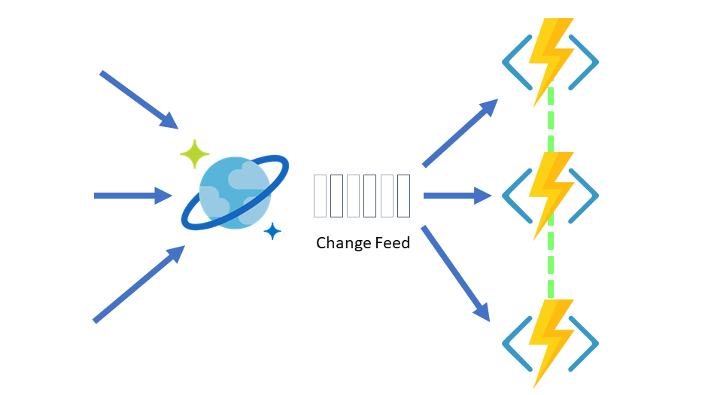
Azure Cosmos DB and Azure Functions
Serverless Event-Based Architectures
Notes:
With the Azure Functions trigger for Cosmos DB, you can leverage the Change Feed Processor’s scaling and reliable event detection functionality without the need to maintain any worker infrastructure. Just focus on your Azure Function’s logic without worrying about the rest of the event-sourcing pipeline. You can even mix the Trigger with any other Azure Functions bindings.
NOTE: Currently, the Azure Functions trigger for Cosmos DB is supported for use with the Core (SQL) API only.

Slide 79
Change Feed Design Patterns
Ch-ch-ch-changes: Tracing Changes in Azure Cosmos DB
Notes:
Azure Cosmos DB is well-suited for IoT, gaming, retail, and operational logging applications. A common design pattern in these applications is to use changes to the data to trigger additional actions.
A common design pattern in these applications is to use the data to trigger additional actions. Examples of additional actions include:
Triggering a notification or call to an API, when an item is inserted or updated.
Real-time stream processing for IoT or real-time analytics processing on operational data.
Data movement such as synchronizing with a cache, a search engine, a data warehouse, or cold storage.

Slide 80
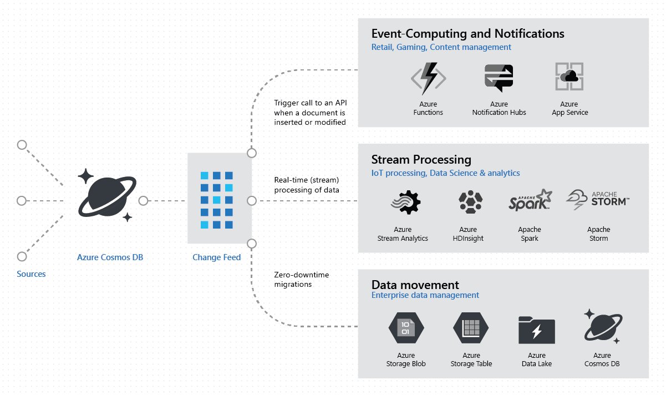
Common Uses of the Change Feed
Change Feed Design Patterns
Notes:
The change feed in Azure Cosmos DB enables you to build efficient and scalable solutions for each of these patterns, as shown here:
NEXT: Event computing and notifications

Slide 81
Common Uses of the Change Feed
Change Feed Design Patterns
Event Computing and Notifications
Notes:
The change feed can simplify scenarios that need to trigger a notification or send a call to an API based on a certain event. You can use the Change Feed Process Library to automatically poll your container for changes and call an external API each time there is a write or update.
You can also selectively trigger a notification or send a call to an API based on specified criteria. For example, if you are reading from the change feed using Azure Functions, you can put logic into the function to only send a notification if a specified criteria has been met. While the Azure Function code would execute during each write and update, the notification would only be sent if specific criteria had been met.

Slide 82
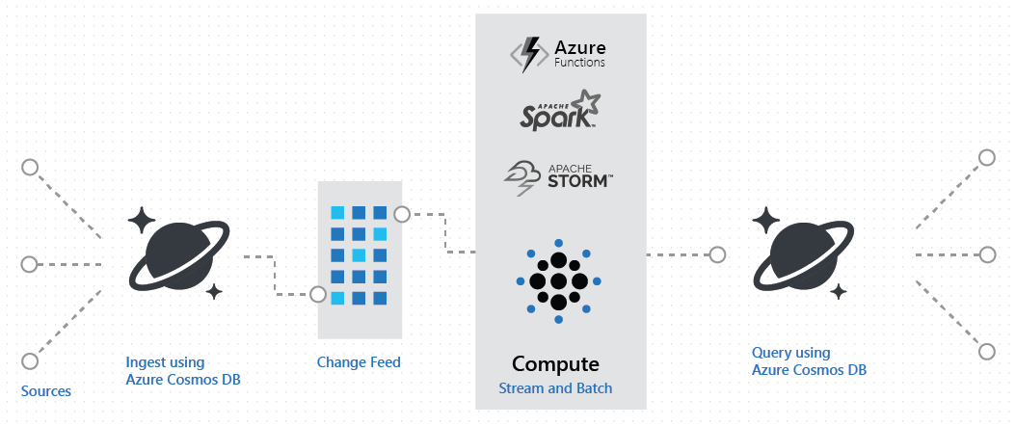
Common Uses of the Change Feed
Change Feed Design Patterns
Event Computing and Notifications
Real-Time Stream Processing
Notes:
The Azure Cosmos DB change feed can be used for real-time stream processing for IoT or real-time analytics processing on operational data. For example, you might receive and store event data from devices, sensors, infrastructure and applications, and process these events in real time, using Spark.
<CLICK> Here we can see how you can implement a lambda architecture using the Azure Cosmos DB via change feed.
In many cases, stream processing implementations first receive a high volume of incoming data into a temporary message queue such as Azure Event Hub or Apache Kafka. The change feed is a great alternative due to Azure Cosmos DB’s ability to support a sustained high rate of data ingestion with guaranteed low read and write latency. The advantages of the Azure Cosmos DB change feed over a message queue include:
Data persistence
Querying ability
High availability

Slide 83
Common Uses of the Change Feed
Change Feed Design Patterns
Event Computing and Notifications
Real-Time Stream Processing
Data Movement
Notes:
You can also read from the change feed for real-time data movement.
For example, the change feed helps you perform the following tasks efficiently:
Update a cache, search index, or data warehouse with data stored in Azure Cosmos DB
Perform zero down-time migrations to another Azur Cosmos account or another Azure Cosmos container with a different logical partition key
Implement an application-level data tiering and archival. For example, you can store “hot data” in Azure Cosmos DB and age out “cold data” to other storage systems such as Azure Blob Storage.
When you have to denormalize data across partitions and containers, you can read from your container’s change feed as a source for this data replication. Real-time data replication with the change feed can only guarantee eventual consistency. You can monitor how far the Change Feed Processor lags behind in processing changes in your Cosmos container.

Slide 84
Common Uses of the Change Feed
Change Feed Design Patterns
Event Computing and Notifications
Real-Time Stream Processing
Data Movement
Event Sourcing
Notes:
The event sourcing pattern involves using an append-only store to record the full series of actions on that data. Azure Cosmos DB’s change feed is a great choice as a central store in event sourcing architectures where all data ingestion is modeled as writes (no updates or deletes). In this case, each write to Azure Cosmos DB is an “event” and you will have a full record of past events in the change feed. Typical uses of events published by the central event store are for maintaining materialized views or for integration with external services. Because there is no time limit for retention in the change feed, you can replay all past events by reading from the beginning of your Cosmos container’s change feed.
Azure Cosmos DB is a great central append-only persisted data store in the event sourcing pattern because of its strengths in horizontal scalability and high availability. In addition, the Change Feed Processor Library offers an “at least once” guarantee, ensuring that you will not miss processing any events.

Slide 85
Demos
Ch-ch-ch-changes: Tracing Changes in Azure Cosmos DB

Slide 86


Basic Change Feed Demo
Change Feed Demos
Data written to Cosmos DB
Insert/Update recorded in the Change Feed
Azure Function is triggered by the item being added to the change feed

Slide 87
Data Archival
Change Feed Demos
Scenario
Practice test application
Data is useful for active queries within 30 days (2,592,000 seconds)
Need to keep archive for historical, compliance reasons
Demo will process 428k records over 24-hour period
Real data that has been autonomized

Slide 88

Data Archival
Change Feed Demos
Application/Device sends data to Cosmos
Cosmos DB receives data
The insert is recorded into the change feed
Azure Function is triggered by the item being added to the change feed
The data is archived in a cold blob storage container

Slide 89
Denormalization
Change Feed Demos
Scenario
Shindig Manager
Manages presentations for different shindigs (events)
Metadata maintained in its own container
Need way to update denormalized data in shindig (event) partitions
Notes:
Could also be used for graph databases where you want to related data keep together in the same container for performant queries

Slide 90
Denormalization
Change Feed Demos
Metadata is updated
Cosmos DB receives updated data
The update is recorded into the change feed
Azure Function is triggered by the metadata being updated to the change feed
Affected documents are updated/written

Slide 91
Replicating Containers
Change Feed Demos
Scenario
Shindig Manager
Manages presentations for different shindigs (events)
Presentations partitioned by shindig
Want to improve query performance when searching across tags (original partitioning would require cross-partition querying)

Slide 92
Replicating Containers
Change Feed Demos
Presentation data is sent to Cosmos by the application
Cosmos DB receives data
The insert/update is recorded into the change feed
Azure Function is triggered by the item being added/updated to the change feed
Document is sent to replicated Cosmos container(s)

Slide 93
Triggering Event-Driven Architecture
Change Feed Demos
Scenario
Shopping cart implementation – Lego store
Implementing an event-driven architecture to allow for asynchronous processing of an order
Note: functions are only simulating doing actions

Slide 94
Triggering Event-Driven Architecture
Change Feed Demos
Fulfillment
User purchases one or more items
Order data is written to Cosmos DB
The shopping cart is recorded into the change feed
Inventory
Notification

Slide 95
Wrap-Up
Ch-ch-ch-changes: Tracing Changes in Azure Cosmos

Slide 96
Wrap-Up
Ch-ch-ch-changes: Tracing Changes in Azure Cosmos DB
Azure Cosmos DB
Notes:
A globally distributed, massively scalable, multi-model database service

Slide 97
Wrap-Up
Ch-ch-ch-changes: Tracing Changes in Azure Cosmos DB
Azure Cosmos DB
Change feed is the unsung here of Cosmos DB
Notes:
The change feed is the unsung hero of Azure Cosmos:
Enabled by default
Includes insert and update operations
Sorted by order of modification
Synchronized from any point-in-time
Changes available in parallel for logical partitions
Applications can request multiple change feeds

Slide 98
Wrap-Up
Ch-ch-ch-changes: Tracing Changes in Azure Cosmos DB
Azure Cosmos DB
Change feed is the unsung here of Cosmos DB
Supported APIs and client SDKs
Notes:
Supported APIs:
SQL API
Cassandra
Mongo DB
Gremlin API
Supported Client SDKs:
.NET
Java
Python
Node/JS

Slide 99
Wrap-Up
Ch-ch-ch-changes: Tracing Changes in Azure Cosmos DB
Azure Cosmos DB
Change feed is the unsung here of Cosmos DB
Supported APIs and client SDKs
Current limitations
Intermediate Updates
Guaranteed Order
Deletes

Slide 100
Wrap-Up
Ch-ch-ch-changes: Tracing Changes in Azure Cosmos DB
Azure Cosmos DB
Change feed is the unsung here of Cosmos DB
Supported APIs and client SDKs
Current limitations
Intermediate Updates
Guaranteed Order
Deletes
Three processes for reading the change feed
Notes:
SDK (Azure WebJobs, Azure Virtual Machine, Azure Kubernetes Service, ASP.NET Hosted Service)
Change Feed Processor
Azure Functions – Only Core (SQL) API only

Slide 101
Wrap-Up
Ch-ch-ch-changes: Tracing Changes in Azure Cosmos DB
Azure Cosmos DB
Change feed is the unsung here of Cosmos DB
Supported APIs and client SDKs
Current limitations
Intermediate Updates
Guaranteed Order
Deletes
Three processes for reading the change feed
Common patterns
Notes:
Common patterns:
Event computing and notifications
Real-time stream processing
Data movement
Event Sourcing

Slide 102
Wrap-Up
Ch-ch-ch-changes: Tracing Changes in Azure Cosmos DB
Azure Cosmos DB
Change feed is the unsung here of Cosmos DB
Supported APIs and client SDKs
Current limitations
Intermediate Updates
Guaranteed Order
Deletes
Three processes for reading the change feed
Common patterns
Demos
Notes:
Demos:
Archival
Replicating containers
Denormalizing data
Triggering APIs for event-driven architecture

Slide 103
Thank You!
chadgreen@chadgreen.com
TaleLearnCode
ChadGreen.com
ChadGreen & TaleLearnCode
ChadwickEGreen

